Slide 1
AMAO Overview
March 2024

Slide 2


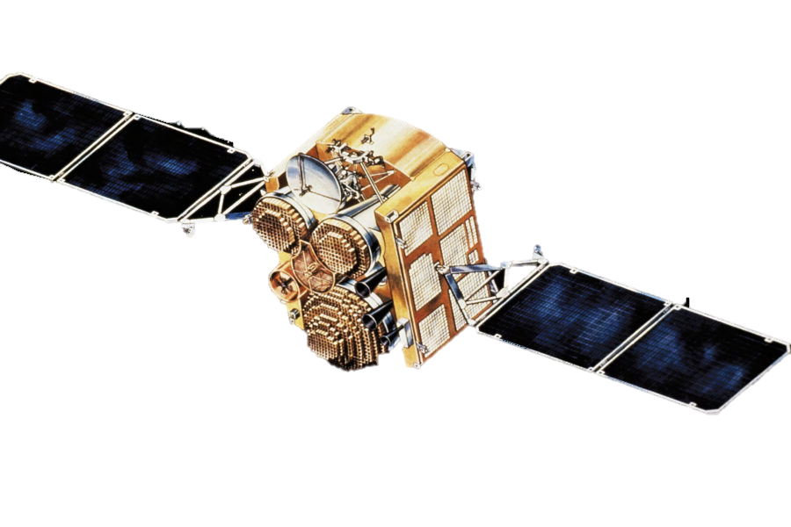


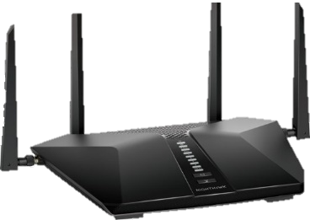
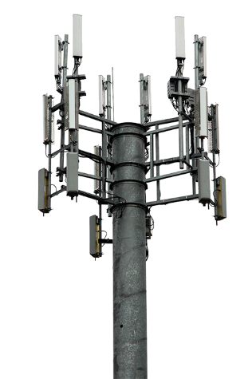
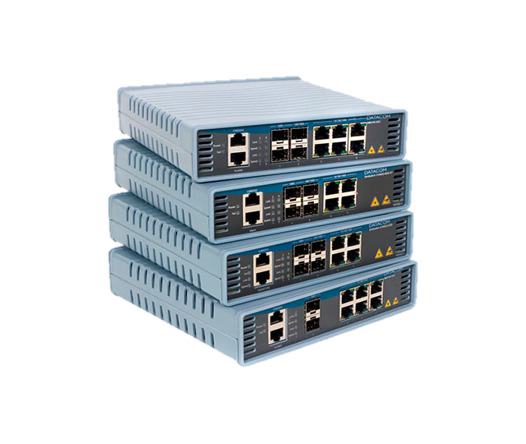
Amphenol Corporation (APH)
% Sales by Market
Industrial
Comm Air
Defense
Automotive
Broadband
Mobile
Networks
Mobile
Devices
IT Datacom
2023 Sales
$12.6 Billion
Corporate
Group
Businesses
Products
Technologies
Markets

Slide 3

Amphenol Corporation (APH)
ROMANIA
HUNGARY
CZECH
REPUBLIC (3)
SLOVAKIA (2)
SWEDEN (2)
% Sales by Region
CANADA (8)
SERBIA
AUSTRIA
POLAND (2)
GERMANY (10)
ESTONIA (3)
SWITZERLAND
FINLAND
FRANCE (8)
RUSSIA
IRELAND
TURKEY
DUBAI
UK (4)
39%
N. America
38%
Asia
NL (2)
SPAIN (2)
HQ
USA (45)
TUNISIA (3)
JAPAN (5)
MOROCCO
KOREA (5)
TAIWAN (5)
20%
Europe
MEXICO (7)
PUERTO RICO
CHINA (51)
3%
ISRAEL (2)
HONG KONG
VIETNAM (2)
ROW
MACEDONIA
INDIA (7)
ITALY (2)
INDONESIA (2)
MALAYSIA (4)
BRAZIL (3)
SINGAPORE (4)
SOUTH
AFRICA
2023 Sales
$12.6 Billion
ARGENTINA (2)
Operations
AUSTRALIA
Sales Locations
~95,000 Employees
Corporate
Group
Businesses
Products
Technologies
Markets

Slide 4
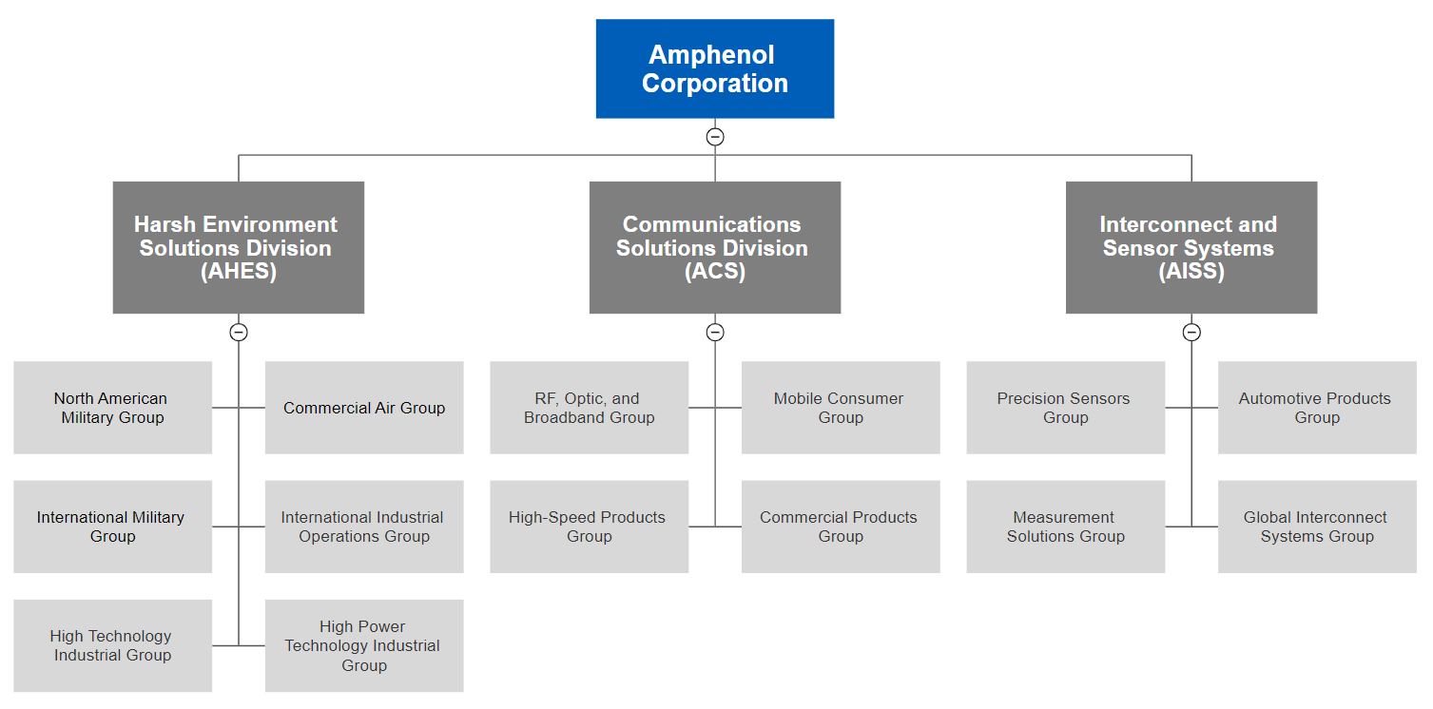
Amphenol Corporation (APH)
AMAO Group
Corporate
Group
Businesses
Products
Technologies
Markets

Slide 5
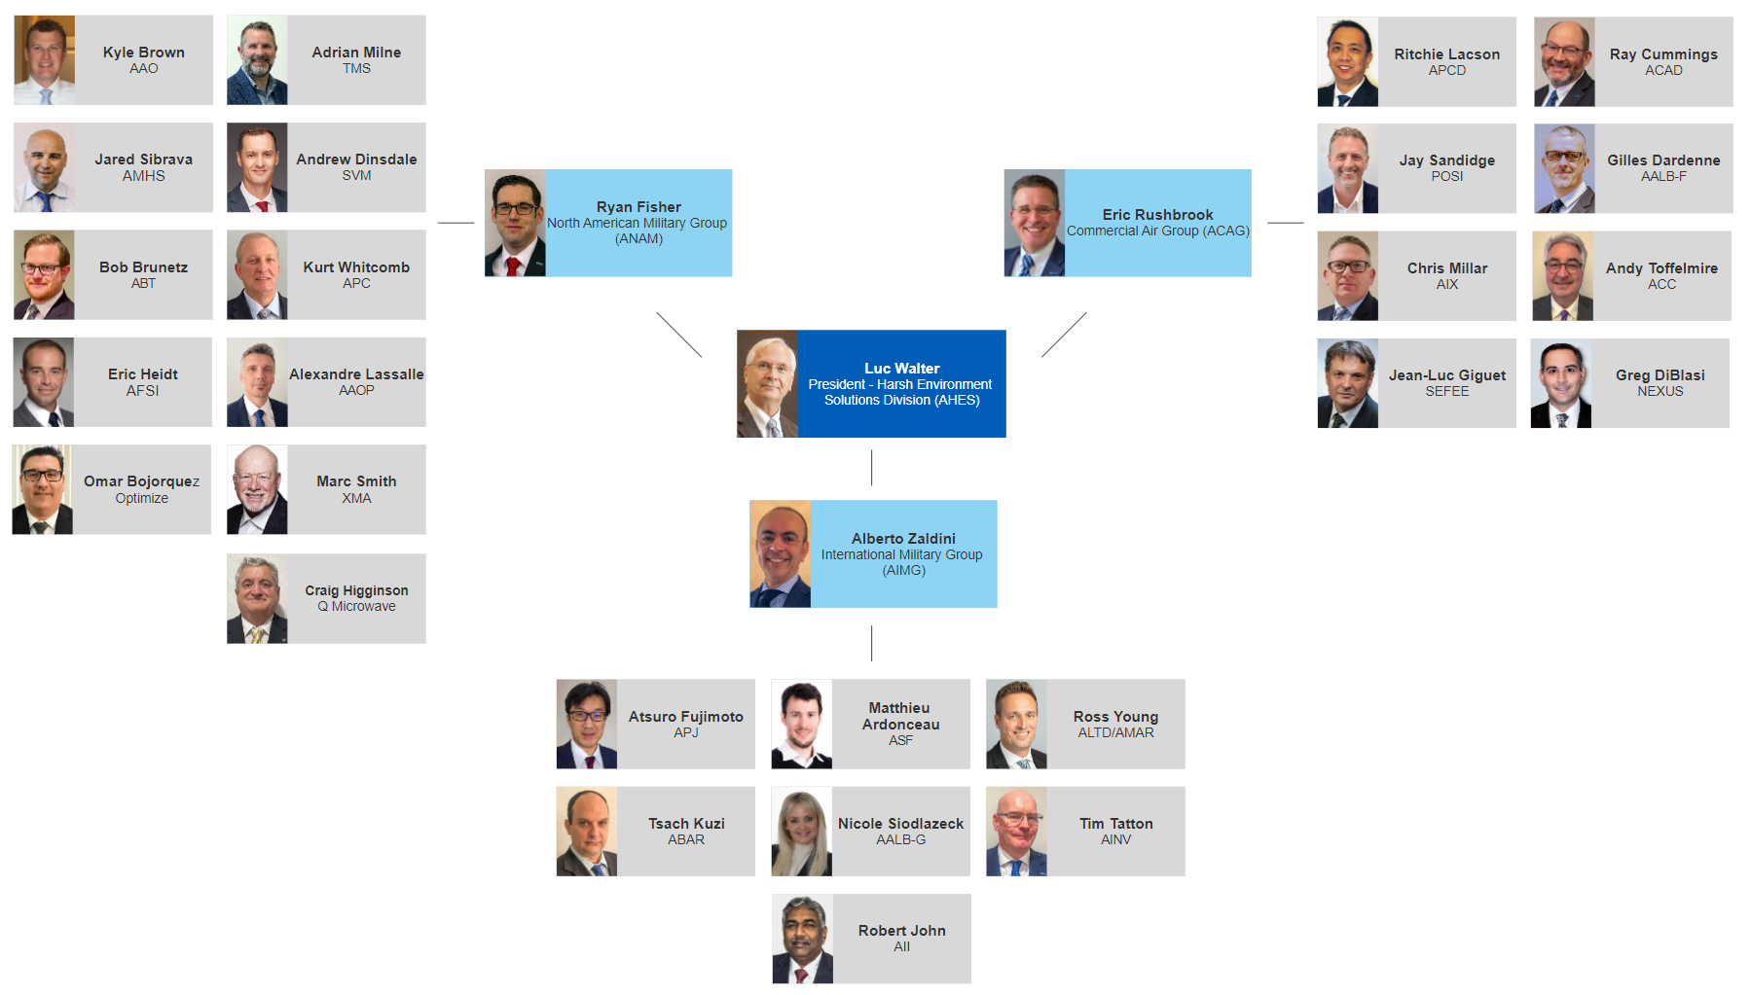
AMAO Group
AMAO management team is configured for collaboration and close alignment with 500 years of Amphenol service across 26 operations
2023 Sales: $2B
Corporate
Group
Businesses
Products
Technologies
Markets

Slide 6

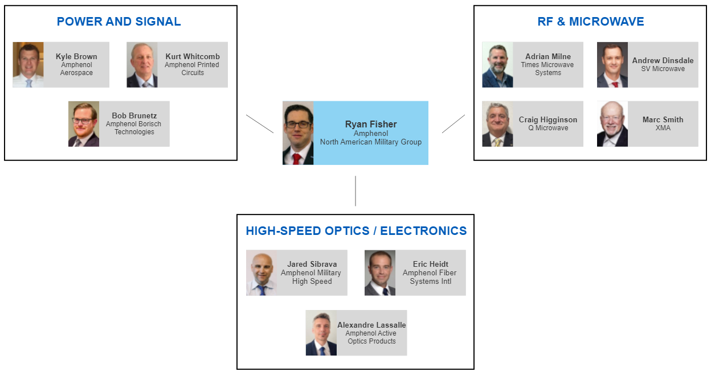
ANAM Group Operations
Corporate
Group
Businesses
Products
Technologies
Markets

Slide 7



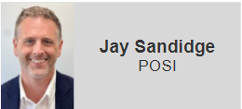





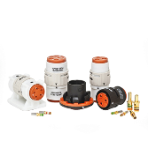
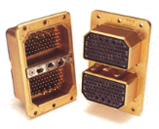
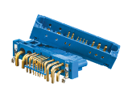
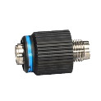

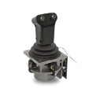

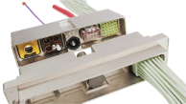
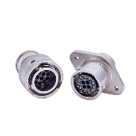
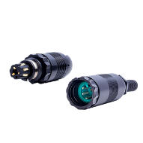
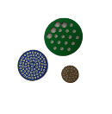
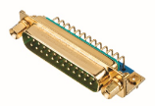
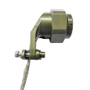
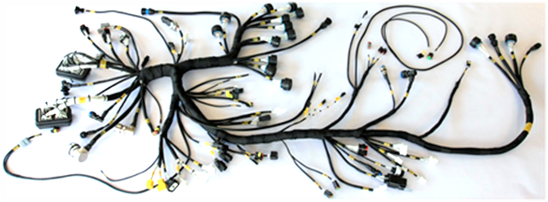
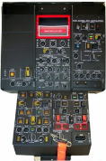
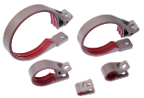

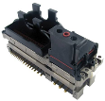



ACAG Group Operations
AirLB-F
Canada
POSI
ACAD
PCD
Nexus
SEFEE
Ionix
Core Products Components and Accessories
Core Products & Resale
Value-Add
Power
Interconnect and Accessories
EWIS/Electronics and Engines
Corporate
Group
Businesses
Products
Technologies
Markets
Notes:
Each of these businesses has an area of focus that I can help with. Whether it be increasing the level of collaboration across the group, with other groups or even other divisions of Amphenol, that’s on thing that I have consistently driven. This also includes the continued expansion of low cost regional mfg capabilities and working to share that across the businesses.
You will certainly be hearing more about these businesses in the general sessions.

Slide 8

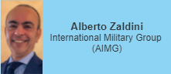

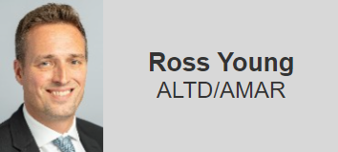
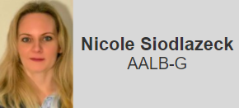



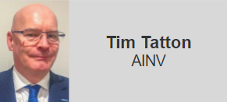
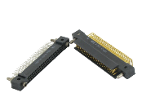
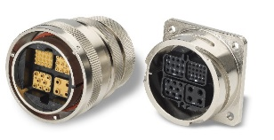
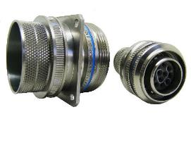
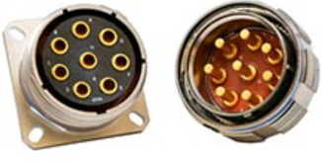
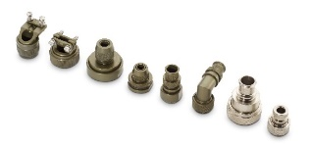
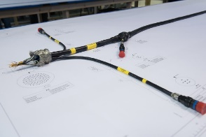
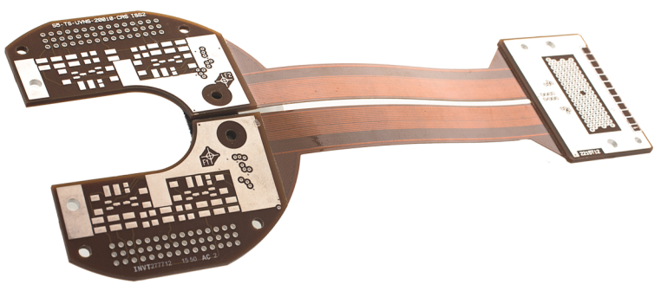
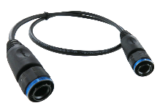
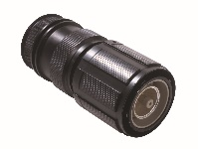
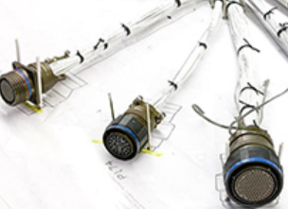

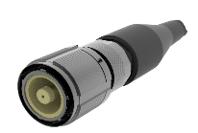
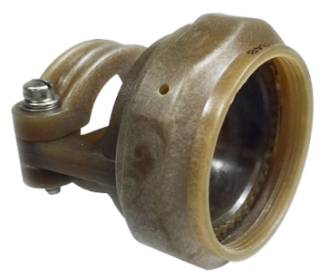
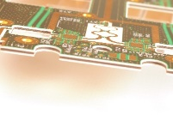
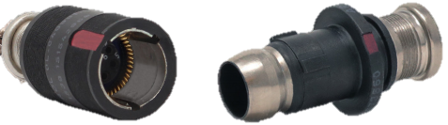
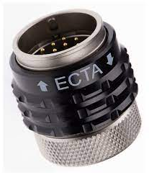
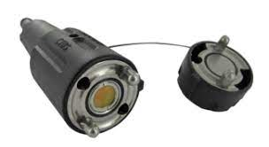
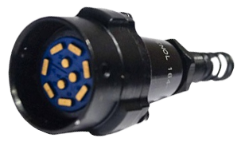
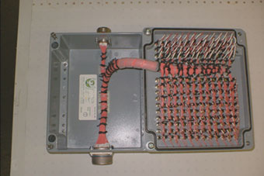
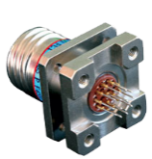
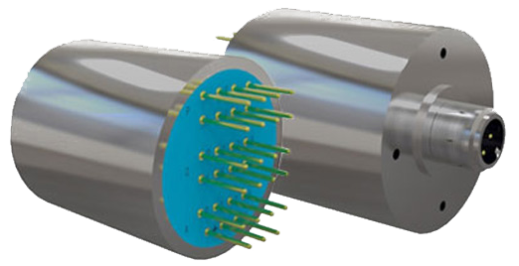
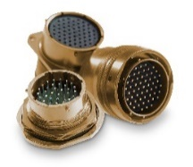
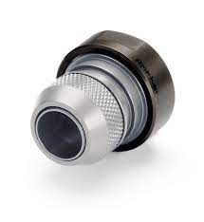
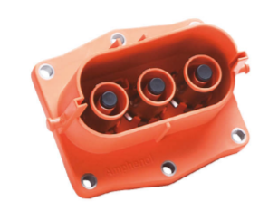




AIMG Group Operations
Socapex
LTD & Martec
AirLB G
APJ
AII
Cablescan
Invotec
Components, Accessories and associated Value-Add
Build-to-print
Corporate
Group
Businesses
Products
Technologies
Markets
Notes:
Each of these businesses has an area of focus that I can help with. Whether it be increasing the level of collaboration across the group, with other groups or even other divisions of Amphenol, that’s on thing that I have consistently driven. This also includes the continued expansion of low cost regional mfg capabilities and working to share that across the businesses.
You will certainly be hearing more about these businesses in the general sessions.

Slide 9

AMAO Global Footprint
AMAO’s global operations offer a local presence capable of building any interconnect solution, often with dual-production locations and low-cost options
2023 Sales: $2B
Corporate
Group
Businesses
Products
Technologies
Markets

Slide 10

AMAO Value Proposition
AMAO can provide all interconnect needs, from small, lightweight system attachments to large, complex assemblies and everything in between
Corporate
Group
Businesses
Products
Technologies
Markets
Notes:
The key to Amphenol’s success in the military and aerospace markets is to combine our world-class design engineering expertise throughout the 22 manufacturing locations with the broadest product portfolio solutions to offer interconnect solutions unmatched in the industry.

Slide 11











Product Portfolio
AMAO has the largest interconnect portfolio in the military and aerospace markets
Circular Connectors
Rectangular & Board Level Connectors
RF Interconnects
Junction Modules Relay Sockets
Terminal Blocks
Contacts & Termini
Cabling & Cable Harnesses
Backshells & System Attachments
High Speed & Fiber Optics
Backplanes | PCBs Flex | Rigid Flex & Assemblies
Media Converters & Ethernet Switches
Complex Systems & Assemblies
Click on Product photos above for more information
Corporate
Group
Businesses
Products
Technologies
Markets
Notes:
Amphenol Military & Aerospace Operations has the largest and broadest selection of interconnect products in the military and aerospace markets. Amphenol can provide all interconnect needs, from small, lightweight system attachments to large, complex assemblies and everything in between. We are qualified on over X00 military and commercial industry specifications and our products are integral to all of the major military and commercial aerospace programs around the globe.

Slide 12






Technology Overview
AMAO is at the forefront of incorporating a wide range of interconnect technologies into the military and aerospace markets
Ruggedization
Harsh environment interconnect solutions
EMI & EMP Protection
Connectors with EMI/EMP protection for sensitive circuits
Size, Weight, and Power
Size and weight reductions combined with increased power requirements
RF Transmission
RF/microwave coaxial connectors, cables, and passive components
High Speed/Fiber Optics
Custom high-speed copper, fiber optic, and integrated solutions
Electronics Packaging
High-reliability electronics design, manufacturing, and assembly
Click on Technology icons above for more information
Corporate
Group
Businesses
Products
Technologies
Markets
Notes:
Each manufacturing location brings a unique combination of technical expertise and manufacturing flexibility to ensure we are the leading interconnect technology provider for the military and aerospace markets. Our worldwide sales organization and the industry’s largest distribution network keep us at the forefront of our customers technology needs and future designs.

Slide 13










Markets Served
AMAO has product and technology solutions with every major customer and program in the military and aerospace markets
Military Aircraft
We design and build high speed, high-reliability, ruggedized product solutions for all subsystems
Ground Systems and Vehicles
Our products meet and exceed the SWaP, high speed, and material requirements for any vehicle subsystem
Commercial Aircraft
We provide product solutions for the smallest business jet and the largest commercial airliner
C4ISR
We provide an array of reliable, rugged, and innovative products to support information collection
Avionics
Our products meet the high-speed, high-density demands of military and commercial aircraft flight systems
Soldier Systems
Our simple, yet powerful connectors save on weight while remaining rugged, comfortable, and efficient
Unmanned Systems
We provide small, lightweight, high-speed products for systems in the air, on land, and at sea
Missiles and Missile Defense
Our high-speed, high-bandwidth, and high-reliability products reduce SWaP and ensure effective missile defense
Space Systems
We work closely with the space industry to ensure we are leading the next generation of interconnect solutions
Naval Systems
Our broad range of products and high reliability ensure save and successful naval missions
Click on Market photos above for more information
Corporate
Group
Businesses
Products
Technologies
Markets

Slide 14

Summary
Technological Expertise
We apply over 90 years of industry-leading knowledge and experience in all markets to design the right solution for you.
Manufacturing Versatility
We utilize the latest manufacturing and process technologies to support our extensive dual production and off-set options around the world.
Superior Customer Engagement & Support
We constantly focus on continuous improvements, from management to local customer support, to build the highest quality, on-time products.
One Company, One Solution
We provide a complete, integrated solution for all system needs, from concept and design to manufacturing and sourcing.

Slide 15
AMAO Business Overview Slides
Corporate
Group
Businesses
Products
Technologies
Markets

Slide 16





Amphenol Borisch Technologies (ABT)
Location: Grand Rapids, MI; Mesa, AZ; Nogales, Mexico; London, ON
Vertically-integrated electronics design and manufacturing firm that specializes in the highest quality service. ABT is the lead integrator within the Amphenol military and aerospace family of interconnect solutions
Product Highlights:
Electro-Mechanical Integration
Design Engineering
Cable & Wire Harnessing
CNC Machining
Circuit Card Assembly
Full Test Capabilities
ISO 9001:2008 and AS9100C:2009
Click on logo above for division website
Corporate
Group
Businesses
Products
Technologies
Markets

Slide 17







Amphenol Aerospace (AAO)
Location: Sidney, NY; Nogales, Mexico; Mesa, AZ; Pune, India
Design and manufacture cylindrical and rectangular, electronic, fiber optic, EMI/EMP filters, and a variety of special applications connectors and interconnect systems
Product Highlights:
D38999 Connector Series
LRM Connectors
Filtered Cylindrical Connectors
Series Five Connectors
2M Connector Series
High-Speed Copper Connectors
R-VPX Connectors
Ruggedized SATA Connectors
Micro-D Connectors
ISO 9001:2008 and AS9100C
Click on logo above for division website
Corporate
Group
Businesses
Products
Technologies
Markets

Slide 18



Amphenol Commercial Air (ACAD)
Location: Sidney, NY; Mesa, AZ; Nogales, Mexico; Pune, India
Specialize in the design and manufacture of interconnect solutions in support of high vibration, harsh environments, electrification and next generation power requirements.
Product Highlights:
D38999 Series III Composite & Stainless Steel
MIL-DTL-83723
MIL-DTL-26482
High-Temperature Engine Connectors
HV38999
Voltarius
Power and charging solutions
High voltage solutions
Dualok Interconnect System
Bulkhead-Feedthrough Connectors
Bantam Bayonet Connectors
ISO 9001:2008 and AS9100C
Click on logo above for division website
Corporate
Group
Businesses
Products
Technologies
Markets

Slide 19






Amphenol Printed Circuits (APC)
Location: Nashua, NH; Nogales, Mexico; Mesa, AZ
Design and manufacture printed circuit boards, backplanes, flex and rigid-flex, and assembly products to meet customers demanding needs
Product Highlights:
State-of-the-art PCB manufacturing equipment and optimized material handling for demanding high-bandwidth systems and mission critical applications
214,000 sq. ft. of manufacturing space, plus advanced assembly and test operations in Nogales, MX for low cost, ITAR-complaint options
ISO 9001 and AS9100
Click on logo above for division website
Corporate
Group
Businesses
Products
Technologies
Markets

Slide 20














Amphenol PCD (APCD)
Location: Beverly, MA; Brossard, QC, Canada; Shenzhen, China; Pune, India; Laguna, Philippines
Design and manufacture a wide range of interconnects, custom or MIL-STD, cable assemblies and accessories, wire management, and In-flight entertainment products for the commercial aerospace and military markets.
APCD is also the channel to market for Amphenol India Interconnect, Socapex, Limited, AirLB France, and AirLB Germany products into North America.
Solutions & Product Highlights:
Custom Cable Solutions
Rugged Network solutions
In-Flight Entertainment Solutions
Circular & Rectangular Connectors
Luminus/Pegasus/Solaris
SIM/EN4165
Fieldbus & RJ-Series
Micro & Nano Ethernet Connectors
Relay Sockets
Junction Modules
System Attachments
Custom & QPL strain reliefs, backshells & dust caps
AS9100-C:2009; ISO 9001:2008; IPC J-STD-001; IPC/WHMA-A-620; MIL-STD-790
Click on logo above for division website
Corporate
Group
Businesses
Products
Technologies
Markets

Slide 21






Times Microwave Systems (TMS)
Location: Wallingford, CT; West Palm Beach, FL; Shanghai, CN; Mesa, AZ; Bangalore, IN
Design and manufacture of high performance flexible and semi-rigid coaxial cable, connectors, and cable assemblies for RF transmission from HF through Microwave frequencies.
Product Highlights:
LMR® Cable, Connectors, Assemblies
MILTECH®
High Performance custom coax
cable assemblies
Phase Critical Assemblies
Surge Protection Products
SilverLine Test Products
High-Density Interconnects
Multiport Products
ISO 9001:2008 and AS9100
Click on logo above for division website
Corporate
Group
Businesses
Products
Technologies
Markets

Slide 22








Amphenol NEXUS Technologies (NEX)
Location: Stamford, CT; Pune, India
Design and manufacture superior military plugs, jacks, and momentary push-button switches. Connectors are specified in applications where reliable harsh environment connectors are required. Switches are designed for applications that demand durable, reliable, and cost-effective switching.
Product Highlights:
M55116-qualified Audio Connectors
Ranger Soldier-Worn Connectors
Telephone Plugs and Jacks
Microphone Plugs and Jacks
Waterproof Breakaway Connectors
Push-Button Switches
Miniature versions of all standard products
ISO 9001:2008
Click on logo above for division website
Corporate
Group
Businesses
Products
Technologies
Markets

Slide 23










Amphenol Military High Speed (AMHS)
Location: Sidney, NY; Nogales, Mexico; Mesa, AZ
The one-stop shop for rugged, high-speed electronics in the military and aerospace industries. High speed copper and fiber rugged Ethernet switches, media converters, contacts, connectors, cables, and more!
Product Highlights:
D38999 Connector Series
VPX Ethernet Switches
Switchbox Ethernet Switches
Media Converters
High Speed/High Density Copper
High-Speed Copper Contacts
Transceivers
Fiber Optic Termini and Ferrules
Fiber Optic Connectors and Cables
ISO 9001:2008 and AS9100C
Click on logo above for division website
Corporate
Group
Divisions
Products
Technologies
Markets
Notes:
Amphenol designs and builds custom connector and cable solutions for High Speed Copper, Fiber Optic, and Integrated applications. AMAO has numerous interconnect options to solve any high-speed data transmission needs from 10 Gb/s and beyond, while incorporating solutions for all high-speed protocols and media conversion.

Slide 24








SV Microwave (SVM)
Location: West Palm Beach, FL; Mesa, AZ
Design and manufacture precision, high performance RF/Microwave coaxial connectors, cable assemblies, adapters and components for mil-aero, space, commercial and telecom markets
Product Highlights:
High Speed 2.92mm, 2.4mm & 1.85mm
Single Port and Multiport Connectors (SMP, SMPM, SMPS series)
PCB Mount – Solder and Solderless options
Millimeter Wave Coaxial Product Line
Adapters – In and Between Series
Components: Attenuators & Terminations
Semi-Rigid and Flexible Cable Assemblies
SOSA/VITA Aligned Backplane and Plug-In Blocks, Connectors & Cable Assemblies
RF Harnesses
ISO 9001:2008 and AS9100C
Click on logo above for division website
Corporate
Group
Businesses
Products
Technologies
Markets

Slide 25







Positronic
Locations: USA, France, India, Indonesia, Singapore
Positronic is a global manufacturer of high reliability electronic connectors, known for its distinctive core capabilities, including solid machined contacts with low resistance/high conductivity for use in standard and quick-turn custom connectors.
Product Highlights:
D-sub and Combo-D connectors
Broad range of military and space
qualified products
Solid, machined contacts
Modular connectors
Large variety of power connectors
PosiBand® contact technology
Custom connectors
Circular and rectangular
connectors
Connector accessories
Select locations certified to ISO 9001, ISO 14001, AS9100, MIL-STD-790
Click on logo above for division website
Corporate
Group
Businesses
Products
Technologies
Markets

Slide 26











Amphenol XMA
Location: Manchester (North Boston, USA), China
Passive coaxial resistive products – thin film, attenuators, terminations, power dividers, couplers, equalizers, termination – servicing RF, microwave, and millimeter wave applications. Components range from DC-65GHz.
1mm
Thin film
Products:
Markets served:
Contact:
Adapters
Attenuators
Directional Couplers
Fixed Equalizers
Power Dividers
Quantum Computing
Telecom
Space
Aerospace and defense
Marc Smith
General Manager
MSmith@xmacorp.com
+1 603 657 4360
Click on logo above for division website
Corporate
Group
Divisions
Products
Technologies
Markets

Slide 27




Amphenol Q Microwave
Location: El Cajon, CA, USA
Microwave-electronics design and manufacturing company specializing in quick-turn and low-cast production of microwave / RF filter products for use by the wireless and military industries.
Products:
Markets served:
Contact:
Integrated Filter Packaging
Lumped Element Filters
Combline Filters
Switched Filter Banks
RF Down- & Upconverters
Radar (land, air, Navy)
EW
Comms
Space
David Higginson
Business Development Director
dhigginson@qmicrowave.com
+1 619 509 8245
Click on logo above for division website
Corporate
Group
Divisions
Products
Technologies
Markets

Slide 28






Amphenol Fiber Systems (AFSI)
Location: Allen, TX
Design and manufacture harsh environment fiber optic connectors and cable assemblies for a wide variety of markets including military, aerospace, medical, broadcasting, and oil & gas.
Product Highlights:
Fiber Optic Cable Assemblies
Fiber Optic Connectors
Physical Contact Fiber Optic Connectors
Expanded Beam Fiber Optic Connectors
Fiber Optic Termini
Hybrid (Copper/Fiber) Connector Solutions
Termination Kits
ISO 9001:2008 and AS9100C
Click on logo above for division website
Corporate
Group
Businesses
Products
Technologies
Markets

Slide 29

















Amphenol Canada (ACC)
Location: Markham, ON, Canada; Belleville, ON, Canada; Nogales, Mexico
Design and manufacture of EMI/EMP filtered connectors, rectangular I/O rack and panel connectors, harsh environment and ruggedized connectors for the military and aerospace markets
Product Highlights:
MMA (Multi Modular ARINC)
ARINC 600
ARINC 404
M83527
Micro-D Connectors (M83513 QPL)
Rectangular 38999 (R39 Series)
R58 Series (M83733)
Specialty Rectangular Connectors
Filtered Connectors
Planar Capacitors
ISO 9001:2015 + AS9100D
Click on logo above for division website
Corporate
Group
Businesses
Products
Technologies
Markets

Slide 30



Amphenol Optimize
Location: Nogales, Mexico
Component manufacturing and final assembly for many of the major product lines within the Amphenol Military & Aerospace group
Product Highlights:
Circular Mil-Spec Connectors
Filter Connectors
Cable Assemblies
High-Speed & Fiber Optic Cable Assemblies
Rectangular & Board Level Connectors
RF Interconnects
Micro-Miniature Connectors
ISO 9001:2008 and AS9100C
Click on logo above for division website
Corporate
Group
Businesses
Products
Technologies
Markets

Slide 31






Amphenol Limited (ALTD)
Location: Whitstable, Kent, UK
Design and manufacturing service for a large range of military and commercial aerospace connectors and interconnect solutions, including cable assembly, over-molding and electronic packaging
Product Highlights:
Power Connectors – ground and aerospace applications
C5ISR and Body Worn
Filter Connectors
MRO & Cable Assembly
Military Standard Connectors
Environmentally sealed connectors
AS9100 Rev D
Click on logo above for division website
Corporate
Group
Businesses
Products
Technologies
Markets

Slide 32





Amphenol Martec (AMAR)
Location: Whitstable, Kent, UK
Perfect connection for mission critical applications!
Martec provides interconnection solutions from concept to supply. Hermetic connectors are essential to maintain system integrity in applications where the reliability and performance of electrical connections is critical, such as gas-tight barriers or high-pressures differentials.
Product Highlights:
New Technologies:
Hermetic Mil Spec Connectors
Glass-to-Metal Seal Sensor headers
Subsea Interconnects
Filtered hermetic Interconnects
Coaxial and High-Speed Hermetic Connectors
Hermetic packaging
Hermetic “Lighter” connectors (titanium housing available now and aluminum housing coming soon)
Hermetic “Hotter” connectors (operational temperatures up to 450°C and firewall capabilities up to 1000°C
EN 9100:2018 and ISO 9001:2015
Click on logo above for division website
Corporate
Group
Businesses
Products
Technologies
Markets

Slide 33





Amphenol Invotec (AINV)
Location: Tamworth, UK & Telford, UK
Manufacturer of time critical, advanced technology and high reliability printed circuit boards
Product Highlights:
Complex Multi-Layer
Flex & Flex-Rigid
Single and Double-Sided Flex & Rigid
HDI – High Density Interconnect
Mixed Dielectric (Hybrid) constructions
RF and Microwave
Power and Thermal Management solutions
IMS – Insulated Metal Substrates
Bonded External Heat Sinks
Embedded components
Printed Electronics
AS9100C:2009, ESA approved, NADCAP (Electronics)
Click on logo above for division website
Corporate
Group
Businesses
Products
Technologies
Markets

Slide 34





Amphenol Ionix Systems (AIX)
Location: Warrington, UK & Kuressaare, Estonia
Manufacture of Wiring Harnesses, Fiber Optic assemblies & RF assemblies, providing low-cost interconnection solutions for aerospace, defense, power generation and other high-performance engineering sectors.
Product Highlights:
Aerospace Engine Harnesses
Military Vehicle Harnesses
eVTOL / Electric / Hybrid aircraft harnesses
IFE Harnesses
Box & Panel Assemblies
Airframe Harnesses
Commercial Aerospace Harnesses
Military Aerospace Harnesses
Over-Braided Harnesses
Overmoulded harnesses
Cabin Seating Harnesses
Ruggedized Assemblies
Fiber-optic assemblies
RF assemblies
On-site support services
EN 9100:2018, ISO 9001:2015, ISO 14001:2015
Click on logo above for division website
Corporate
Group
Businesses
Products
Technologies
Markets

Slide 35




Amphenol Cablescan (ACAB)
Location: Brough, UK; Nagele, NL
Manufacture high performance electrical cable assemblies and control panels for aerospace, defense and commercial applications.
Product Highlights:
Harnesses for commercial & industrial applications
RF cable assemblies
Power & battery cables
Box build / panel build
Laser marking
Machine overbraiding
Automatic testing
Cable assembly, panel repair & overhaul
AS9100 Rev. D & ISO 9001:2015
Click on logo above for division website
Corporate
Group
Businesses
Products
Technologies
Markets

Slide 36






Amphenol Air LB France (AALB-F)
Location: Wé, Carignan, France
Design and manufacture composite and metallic rectangular, shielded and sealed connectors and interconnect solutions, as well as accessories for wiring and fixing, for commercial and military aerospace applications.
Product Highlights:
Distribution Modules
Relay Sockets
Terminal Blocks
EN4165/SIM Modular Connectors
System Attachments
Optical connectors
EN3545/1900 Connectors
ASR Series
Bus Bars
EN9100:2009 , ISO9001:2008 & ISO14001:2004
Click on logo above for division website
Corporate
Group
Businesses
Products
Technologies
Markets

Slide 37













Amphenol-Air LB Germany (AALB-G)
Location: Saarlouis, Germany
Our service spectrum includes passive components such as military and aerospace connectors as well as application-specific special developments, fiber optics and system solutions.
Product Highlights:
VG Connector Series
D38999 Connector Series
Sealed D-Sub connectors
Spacers 3308
Low Frequency Distribution Modules supporting ARINC429
Circular Connectors
Conductive seals for all series up to 10 GHz
Circular Modular Connectors
Reverse Bayonet Modular
EN 9100:2018; ISO 9001:2015; ISO 14001:2015; ISO 45001:2018; ISO 50001:2018 & DIN EN ISO/IEC 27001:2017
Click on logo above for division website
Corporate
Group
Businesses
Products
Technologies
Markets

Slide 38






Amphenol SEFEE
Locations: Saint-Affrique; Brive, Velaux (France); Bangalore (India)
Vertically integrated design and manufacture of electrical harnesses and electronic equipment for the Aerospace and Military markets. Sefee provides airworthy build-to-specs, build-to-print solutions and qualified on-site services.
Product Highlights:
Harnesses for Aerostructures
Electro-Mechanical assemblies
Power Distributions Units
Avionics, Data Concentrators
Joysticks
NVIS controls
Final Assembly (FAL)
Offloading
EN9100:2009 & ISO9001:2008; Part 21G, Part 145, FAA, TCAC compliant
Click on logo above for division website
Corporate
Group
Businesses
Products
Technologies
Markets

Slide 39








Amphenol Socapex (ASF)
Location: Thyez, France; Pune, India
Since 1947, Amphenol Socapex has prescribed, designed and manufactured reliable and innovative interconnection solutions for harsh environments, specializing in standard and customized electrical and fiber optic connectors, contacts, accessories and cabling solutions.
Product Highlights:
38999 Series I, II and III & derived
2M Micro Miniature
Rugged Ethernet, USB, Display Solutions
Printed Circuit Board Solutions
High Speed Solutions
Fiber Optics Solutions
Electrical & Optical Harnesses
Harness in a box
Signal, Power & High-Speed Contacts
Custom Solutions
EN9100:2009 & ISO9001:2008
Click on logo above for division website
Corporate
Group
Businesses
Products
Technologies
Markets

Slide 40







Amphenol Active Optics Products (AAOP)
Location: Berlin, Germany
Amphenol AOP designs and manufactures optical transceivers for the datacom, military and aerospace markets. The team has more than 18 years’ proven track record in designing and manufacturing optoelectronic products. Core competencies in RF, optical packaging, optical engine integration.
Product Highlights:
SCFF RG
LEAP® OBT Rugged
LEAP® OBT Standard
QEPT Product Family
Media Converters
Switches
Accessories and Complementary Products
Rugged Active Optical Cables
ISO9001 & ISO14001
Click on logo above for division website
Corporate
Group
Businesses
Products
Technologies
Markets

Slide 41


Amphenol India (AII)
Location: Bangalore & Pune, India
Low cost, offset solution for electrical, electronic and fiber optic connectors, coaxial and flat-ribbon cable, and interconnect systems
Product Highlights:
Circular Connectors
Audio Connectors
PCB Connectors
Backshells
RF Connectors
Fiber Optic Connectors
Power Connectors
Rack & Panel Connectors
EN9100:2009 & ISO9001:2008
Click on logo above for division website
Corporate
Group
Businesses
Products
Technologies
Markets

Slide 42





Amphenol Japan (APJ)
Location: Ritto, Japan
Design, manufacture and sale of MIL standard connector, custom connectors, and cable harnesses to the Japanese market
Product Highlights:
Mil-Spec Circular Connectors
Custom Circular Connectors
Micro-D Connectors
LRM Connectors
Brush Connectors
Fiber Optic Connectors
High-Speed Copper Connectors
Fiber Optic Cable Assemblies
High-Speed Copper Cable Assemblies
ISO9001 & ISO 14001
Click on logo above for division website
Corporate
Group
Businesses
Products
Technologies
Markets

Slide 43





Amphenol Italy
Location: Milan, Italy
The main location of European Sales within Amphenol Military and Aerospace Operations which promotes the full range of the Group.
Product Highlights:
Mil-Spec Circular Connectors
Custom Circular Connectors
Rectangular Connectors
Fiber Optic Connectors
Backshells and System Attachments
RF/Mil Aero Connectors
Cable Assemblies
Printed Circuit Boards and Backplanes
Click on logo above for division website
Corporate
Group
Businesses
Products
Technologies
Markets

Slide 44







Amphenol Bar-Tec
Location: Kfar-Saba, Israel
Markets and design-in Amphenol military and aerospace products to the defense industry in Israel. Bar-Tec promotes the full range of Amphenol Military-Aero connectors from high current connectors to fiber optics
Product Highlights:
Mil-Spec Circular Connectors
Custom Circular Connectors
Rectangular Connectors
Fiber Optic Connectors
Backshells and System Attachments
RF/Mil Aero Connectors
Cable Assemblies
Printed Circuit Boards and Backplanes
Click on logo above for division website
Corporate
Group
Businesses
Products
Technologies
Markets

Slide 45






Amphenol Trackwise Designs
Location: Tewkesbury and Stonehouse, UK
UK-based manufacturer of specialist products using printed circuit technology. Design and manufacture multi-layer flexible printed circuits of unlimited length.
Product Highlights:
Patented manufacturing process offers both traditional, point-to-point interconnects along with Advanced PCBs.
Experience, capability, and available capacity to manufacture interconnects on a large scale.
Stonehouse manufacturing plant currently has 150,000m² per year capacity.
Further capacity expansion available
Click on logo above for division website
Corporate
Group
Businesses
Products
Technologies
Markets

Slide 46
AMAO Product Portfolio Slides
Corporate
Group
Businesses
Products
Technologies
Markets

Slide 47



Circular Connectors
Amphenol has dominated the circular connector market for over 70 years with qualifications for every major military specification. With extensive design experience in custom and special designs for applications both big and small, Amphenol's circular product breadth is unmatched.
Mil-Spec Connectors
Micro-Miniature Connectors
Filtered and Sealed Connectors
Engine Connectors
Audio Connectors
Circular Rack and Panel Connectors
High-Power Connectors
Quick-Disconnect/Push-Pull Connectors
Click on slide title or product images above for more information
Corporate
Group
Businesses
Products
Technologies
Markets

Slide 48



Rectangular & Board Level Connectors
Amphenol provides a wide variety of rectangular and board level interconnect options for mission critical applications by incorporating numerous technologies, such as high data transfer rates, ruggedization, modularity, and hybrid designs, into robust solutions.
Rectangular Connectors
Board-Level Connectors
Rack and Panel Connectors
D-Sub and Micro-D Connectors
Filtered and Sealed Connectors
SIM/Modular Connectors
VITA Interconnects
Click on slide title or product images above for more information
Corporate
Group
Businesses
Products
Technologies
Markets

Slide 49




RF Interconnects
Amphenol designs and manufactures high performance RF/Microwave coaxial connectors, cable assemblies, adapters and components; from commercial-off-the-shelf (COTS) items to custom, precision products with unparalleled engineering expertise and manufacturing capabilities.
Precision, High-Frequency Connectors
Blindmate/Push-On Series
Threaded Series
Coaxial PCB Mount
Solderless Compression Mount PCB Connectors
Pre-tinned PCB Connectors
Multiport High Density Connectors and Cable Assemblies
High-Speed Coaxial Cable Assemblies
Click on slide title or product images above for more information
Corporate
Group
Businesses
Products
Technologies
Markets

Slide 50



High Speed & Fiber Optics
Amphenol continues to match the industry's high speed data increases and systems expansion with a wide range of copper and fiber optic interconnect solutions, from contacts and termini to complex integrated systems, that showcase both design and manufacturing technical excellence.
10GB+ Copper Connectors
USB, HDMI Solutions
ARINC 801 Connectors
TFOCA, TFOCA II, TFOCA III Connectors
LC and MT Circular Connectors
Rugged Ethernet Solutions
Fiber-to-Antenna Connectors
Click on slide title or product images above for more information
Corporate
Group
Businesses
Products
Technologies
Markets

Slide 51




Junction Modules | Relay Sockets | Terminal Blocks
Amphenol's robust and reliable product offering meets and exceeds mil-spec performance requirements through creative application solutions ranging from standard designs to brand-new I/O designs which provide reduced installation time and reduced system weight.
Grounding Modules
Electronic Splices
Quick-Mount Relay Sockets
PCB Modules
In-Line Junctions
Ground Blocks
Mil-Spec Relay Sockets
Click on slide title or product images above for more information
Corporate
Group
Businesses
Products
Technologies
Markets

Slide 52


Cabling & Cable Harnesses
Amphenol has the capabilities to meet a diverse range of cable and harness assembly needs with over 550,000 sq. ft. of manufacturing space and locations around the world to design and build anything from simple point-to-point cables and pigtails to complex multi-branch harnesses.
High-Speed and Fiber Optic Cables
Engine Harnesses
Heavy Duty Power Cables
Overmolded Cable Assemblies
Ethernet and USB Cables
Cable Adapters
RF Cable Assemblies
Click on slide title or product images above for more information
Corporate
Group
Businesses
Products
Technologies
Markets

Slide 53




Contacts & Termini
Amphenol's vast connector portfolio is perfectly complemented by its equally broad portfolio of standard and high-speed contacts and fiber optic termini. Together they provide endless interconnect design options for any system application.
Quadrax, Differential Twinax
ARINC 801 Termini
MT Ferrules
PC Tail Coax, Twinax, Triax Contacts
EN3155 Contacts
Oval Contact System
Fiber Optic Lux Beam & Lumiere
Quadrax Fiber Optic Adapters
Click on slide title or product images above for more information
Corporate
Group
Businesses
Products
Technologies
Markets

Slide 54



Backshells & System Attachments
Amphenol's extensive line of complementary interconnect products provide strain relief, EMI/RFI shielding, and manage cable harnesses throughout aircraft and vehicles. They're engineered with strength, stability, and weight reduction in mind, whether it's a standard backshell or a complex system attachment.
Environmental & Non-Environmental Backshells
EMI/RFI Backshells
Adapters & Strain Reliefs
Dust Caps
P-Clamps & C-Clamps
Standoffs & Raceways
Cable Separators
Click on slide title or product images above for more information
Corporate
Group
Businesses
Products
Technologies
Markets

Slide 55




Backplanes | PCBs | Flex | Rigid Flex & Assemblies
Amphenol has extensive manufacturing and technical expertise to design large custom backplane assemblies, with high layer counts and small-diameter PTH technology, as well as complex flex/rigid-flex assemblies with single-sided, double-sided, multilayer flexible material.
Standard PCBs
Flex Products
Rigid-Flex Products
Backplane Assemblies
Printed Electronics
RF Printed Circuit Boards
Circuit Card Assemblies
Click on slide title or product images above for more information
Corporate
Group
Businesses
Products
Technologies
Markets

Slide 56




Media Converters & Ethernet Switches
Amphenol utilizes its large high-speed interconnect offering to design and build media conversion devices that convert copper to fiber, fiber to copper, and analog to digital, as well as ethernet switches that provide continuous and secure data transmission between communication equipment.
Copper-to-Fiber Digital Media Converters
Analog-to-Digital Media Converters
Ethernet Media Conversion
Opto-Electronic Contacts
Rugged Ethernet Switches
Expanded Beam Converters
Butt Joint Fiber Connector
Click on slide title or product images above for more information
Corporate
Group
Businesses
Products
Technologies
Markets

Slide 57




Complex Systems & Assemblies
Amphenol's vertically integrated supply chain culminates with the design and manufacture of complex integrated systems unrivaled in the interconnect industry by combining the largest interconnect portfolio with global manufacturing versatility, cost-effective partnerships, and technology proliferation.
Electro-Mechanical Integration
Panel Assemblies
Engine & Systems Controls
Aircraft Ground Support Equipment
Ruggedized Displays
Electronic Assemblies
Test Systems
Click on slide title or product images above for more information
Corporate
Group
Businesses
Products
Technologies
Markets

Slide 58
AMAO Technology Overview Slides
Corporate
Group
Businesses
Products
Technologies
Markets

Slide 59






Ruggedization
Amphenol has the broadest range of ruggedized, harsh environment interconnect solutions in the industry. For over 60 years, AMAO has led the military and aerospace industries with countless designs that withstand high altitude and temperature ranges, shock, vibration, humidity, and the harshest sealing requirements.
Product Highlights:
Series Five:
D38999 performance, but 20% smaller and 50% lighter. Standard mil-spec interfaces.
Rhino Series:
High power & voltage applications in harsh environment conditions
Composite EN4165:
Modular, multifunctional composite rectangular connector
Custom Hermetic Feedthroughs:
Provide sealing able to withstand pressures up to 60,000psi
ARINC 600:
The recognized standard harsh environment rack and panel connector for aircraft applications
Dualok:
Enhanced anti-decoupling mechanism that can be used on virtually any cylindrical plug connector and backshell
Click on technology icon or product images above for more information
Corporate
Group
Businesses
Products
Technologies
Markets

Slide 60






Size, Weight, and Power
Amphenol has more interconnect options to reduce size and weight, while maintaining needed power requirements, than any other manufacturer. From system attachments to complex assemblies, AMAO has led the industry in the use of lightweight materials, high contact density design, and unique packaging without sacrificing power and performance.
Product Highlights:
Series Five:
D38999 performance, but 20% smaller and 50% lighter. Standard mil-spec interfaces.
Pegasus Series: Lightweight, small size, and EMI shielding in a rugged, harsh environment connector
TAC Connectors:
Meets MIL-DTL-55116 requirements at half the size of the standard connectors
P-Clamps:
Clamps have overmolded silicone cushion with PEEK polymer; non-conductive/non-corrosive, lightweight, and very durable
Gladiator:
Small, lightweight, and flat connector designed for soldier worn applications -- data sharing, battery charging, and peripheral connectivity.
Cable Adapters:
Complete range of high-performance Cable Adapters
Click on technology icon or product images above for more information
Corporate
Group
Businesses
Products
Technologies
Markets

Slide 61







High Speed/Fiber Optics
Amphenol designs and builds custom connector and cable solutions for High Speed Copper, Fiber Optic, and Integrated applications. AMAO has numerous interconnect options to solve any high-speed data transmission needs from 10 Gb/s and beyond, while incorporating solutions for all high-speed protocols and media conversion.
Product Highlights:
uCom 10Gb+ Series:
High speeds in a rugged, micro-miniature interconnect solution
Centaur:
Data rates up to 56 Gbps in a ruggedized, lightweight aluminum MIL-DTL-38999 shell
Fiber-to-Antenna (FTTA) Connector Solutions: Combines fiber optic LC components and copper contacts in a rugged, affordable package
LEAP OBT: Rugged 12-channel duplex optical transceiver capable of running data-rates of up to 16Gbps per channel on multi-mode fiber
R-VPX Ruggedized
VITA 46:
Ruggedized, high-speed, board-to-board interconnect system with data rates up to 10 GB/s
Octonet Contacts: Superior Ethernet contact system for MIL-DTL-38999 Series III-style connectors
Click on technology icon or product images above for more information
Corporate
Group
Businesses
Products
Technologies
Markets

Slide 62







EMI & EMP Protection
Amphenol’s EMI & EMP Protection solutions offer the versatility of standard connectors with EMI/EMP protection for sensitive circuits. Internal housing of the EMI/EMP devices eliminates costly and bulky exterior discrete protection devices. Virtually all circular and rectangular connectors can be incorporated with filter devices.
Product Highlights:
Mil-Spec Circular
Filter Connectors:
The versatility of standard connectors with EMI/EMP protection for sensitive circuits
AlumaLight:
Exceeds performance and functionality of Mil-standards and is more durable than composites with enhanced EMI performance
RF DC Block Lightning Protector:
High performance series uses a filter circuit to provide lightning protection over the 2000-6000MHz frequency band
Filtered ARINC Connectors:
Filtered rack and panel connectors designed to provide space and cost-effective solutions to avionics EMC compliance issues
Grounded Connectors: Feature specific metallic inserts to provide an electrical continuity between the shell and contacts
ASR Connectors:
Compact, easy to use interconnect where shielding, sealing, and space-savings are prime requirements
Click on technology icon or product images above for more information
Corporate
Group
Businesses
Products
Technologies
Markets

Slide 63







RF Transmission
Amphenol designs and manufactures standard and custom RF/Microwave coaxial connectors, cable assemblies and passive components designed for military, satellite, aerospace, and commercial applications. AMAO has the most extensive RF connector Mil-Spec product offering of any supplier, including adapters, attenuators, and terminations.
Product Highlights:
VITA 66.5: Latest addition to the RF/coaxial section of the VPX platform -- VITA 66.5 RF/Fiber Hybrid connectors
Millimeter Wave Series:
High speed 2.92mm, 2.4mm & 1.85mm connectors, cable assemblies & adapters (DC – 67 GHz)
RF Printed Circuit Boards: Printed circuit board consisting of one or more conductive layers used in High-Frequency antenna and radar applications
Multiport High
Density Connectors:
Provides connectivity and maintainability with quick mate/de-mate of multiple cable assemblies
High Speed RF
Cable Assemblies:
Complete line of high frequency cable assemblies featuring low solder wicking and high cable flexibility
PhaseTrack
Cable Assemblies:
Designed for applications demanding minimal phase change over temperature
Click on technology icon or product images above for more information
Corporate
Group
Businesses
Products
Technologies
Markets

Slide 64







Electronics Packaging
At Amphenol, we understand that high reliability electronics requires state-of-the art equipment, experienced and passionate people, and rigorous process validation. AMAO’s expertise in electronics design, design-for-manufacturer, assembly, and test is second-to-none in the industry.
Product Highlights:
Configurable Interconnects:
Custom interconnect devices with embedded intelligence and processing capability
Harnesses and Cable Assemblies: Harnesses are typically open-loomed or over-braided to precise electrical systems, environmental, and mechanical requirements
Copper-to-Fiber
Digital Media Converters:
Copper-to-fiber and fiber-to-copper media conversion with our hybrid integrated connectors
Ethernet Switches:
Continuous and secure data transmission between all communication equipment
Remote Data Concentrators:
Converts analog and discrete signals to digital format for streaming over the databus of any aircraft management system
Electronic Assemblies: High reliability electronics that meet or exceed all requirements and expectations
Click on technology icon or product images above for more information
Corporate
Group
Businesses
Products
Technologies
Markets

Slide 65
AMAO Markets Served Slides
Corporate
Group
Businesses
Products
Technologies
Markets

Slide 66







Military Aircraft
Amphenol designs and builds high-speed, high-reliable, ruggedized product solutions for all subsystems in proven legacy aircraft, the newest unmanned aircraft or rotorcraft, or the most technologically advanced future military aircraft.
Product Highlights:
RNJ:
Connects electrical or optical rack and panel without any coupling / uncoupling system. MIL DTL 38999 derivative.
LRM Connectors:
Meet the high density needs of today’s integrated electronic modules
MilTech Cable Assemblies:
Designed and qualified to the harshest operating conditions and requirements of military aircraft
Analog-to-Digital Media Converters:
Integrated Converters support input through HF 50Ω MMCX RF type interconnects in a rugged, SFF MIL-DTL-38999 package
VITA 67.1/2 Products:
The RF addition to the VPX platform utilizes floating SMPM contacts to ensure excellent RF performance in any mating condition
Electro Mechanical Integration:
Robust operations, engineering, and quality systems to build complex assemblies
Click on market photo or product images above for more information
Corporate
Group
Businesses
Products
Technologies
Markets

Slide 67







Commercial Aircraft
Amphenol follows the latest trends in the commercial aerospace market to ensure we provide the right product solutions for the smallest general aviation and business jet to the largest commercial airliner.
Product Highlights:
HTC Titanium:
Titanium connectors with comparable performance to Stainless Steel, but with a 30% weight-savings
Luminus Series:
Lightweight, cost-effective connectors that are highly reliable and simple to use
Bantam Micro
Bayonet Connectors:
Where electrical performance must be met with affordability in aerospace applications
EN 4165 / SIM
Monomodule Connectors:
Mono-modular, push-pull connector ideal for IFE, Cabin Service Systems, and other system requirements
Engine &
Systems Controls:
Manufacture electronic assemblies that control and operate APUs, turbine engines, and other systems
Aerostructure
Cable Assemblies:
Build-to-spec and/or build- to-print requirements to form boards of electrical harnesses
Click on market photo or product images above for more information
Corporate
Group
Businesses
Products
Technologies
Markets

Slide 68



Avionics
Amphenol's product portfolio, from terminal blocks and relay sockets to complex solutions combining fiber optics, EMI/EMP protection, backplane assemblies, and custom metal machining, meet the high-speed, high-density demands of flight control systems.
Product Highlights:
Multiport High Density Connectors:
Provides connectivity and maintainability with quick mate/de-mate of multiple cable assemblies
PTNC Series:
Precision version of the TNC offers users superior electrical characteristics
Board Level/Rectangular
Fiber Optics:
Wide range of rectangular connectors containing M29504, HD20, MT Ferrule Fiber Optic Termini, ARINC 801 Termini, & LuxBeam FO termini
R-VPX Ruggedized VITA 46:
Ruggedized, high-speed, board-to-board interconnect system with data rates up to 10 GB/s
RF Printed Circuit Boards:
Printed circuit board consisting of one or more conductive layers used in High-Frequency antenna and radar applications
High Speed
RF Cable Assemblies:
Complete line of high frequency cable assemblies featuring low solder wicking and high cable flexibility
Click on market photo or product images above for more information
Corporate
Group
Businesses
Products
Technologies
Markets

Slide 69





Unmanned Systems
Amphenol's product innovations continue to expand as the unmanned systems market expands, where the newest projects place a premium on small, lightweight, high-speed developments for air, land, and sea unmanned systems.
Product Highlights:
Micro-D Connectors:
Small interconnect solutions, which exceed M83513 requirements, can be designed for many custom solutions
Blind Mate
Antenna Solutions:
Enables design engineers to convert most existing RF antennas into Blind mate "plug in and forget" quick release antennas
uCom 10GB+ Series:
High speeds in a rugged, micro-miniature interconnect solution
Pegasus Series:
Lightweight, small size, and EMI shielding in a rugged, harsh environment connector
Mil/Aero SIM Splices:
Modular composite splice provides a reliable and simple connection between two EN4165 / SIM modules
Encapsulated Harnesses:
Where extra protection is needed for harsh environments, reduced susceptibility to ingress from FOD
Click on market photo or product images above for more information
Corporate
Group
Businesses
Products
Technologies
Markets

Slide 70




Space Systems
Amphenol's rich history with space-related product developments found on landmark space achievements has evolved into the leading manufacturer designing interconnect solutions for the next generation of space exploration to Mars and beyond.
Product Highlights:
Rectangular 38999 (R39):
Delivers the same reliable, familiar benefits found in the circular 38999 connector
Space ST Connectors:
Fiber optic M83522 style connector and strain relief boot compliant to NASAEEE-INST-002 for space applications
Hermetic Connectors:
Hermetic connectors providing seals able to withstand pressures of up to 60,000psi for use in hostile environments
Series Five:
D38999 performance, but 20% smaller and 50% lighter. Standard mil-spec interfaces.
RF Printed Circuit Boards:
Printed circuit board consisting of one or more conductive layers used in High-Frequency antenna and radar applications
Electronic Assemblies:
High reliability electronics
that meet or exceed all requirements and expectations
Click on market photo or product images above for more information
Corporate
Group
Businesses
Products
Technologies
Markets

Slide 71






Ground Systems & Vehicles
Amphenol’s innovative engineering and diverse product offerings meet and exceed the challenges of SWaP, high speed, and material restrictions for any vehicle sub-system, such as C4I systems, power distribution, and active protection systems.
Product Highlights:
MIL-DTL-38999 Series III Connectors:
Highest performance capabilities for both general duty and severe environment applications
MMA Blind Mate:
MMA combines the best features from product lines including ARINC 600, RF, Fiber Optic, and Quadrax
Rhino Series:
High power & voltage applications in harsh environment conditions
Multi-Channel Fiber Optic Cable Assemblies:
Custom cable assemblies using all connector standards for virtually any application
RF High Power Cable Assemblies:
High power TNC/Type N rugged cable assemblies for harsh environments
Voltarius:
High-power interconnect system optimized for high voltage applications up to 1000VDC and 450A and features proven RADSOK® technology
Click on market photo or product images above for more information
Corporate
Group
Businesses
Products
Technologies
Markets

Slide 72





C4ISR
Amphenol provides a reliable, rugged, and innovative array of products to support the important task of information collection. From powering individual systems to providing secure and efficient transfer of data, Amphenol has the technology to accommodate any C4ISR application.
Product Highlights:
TAC Connectors:
Meets MIL-DTL-55116 requirements at half the size of the standard connectors
AN/PRC 117G and
AN/PRC 152 Connectors:
Designed to interface with the AN/PRC-117G and AN/PRC-152 military radio data connector
Headset and Soldier Accessory Cables:
Design and build soldier-worn and ruggedized tactical communication cable assemblies
Mil-Spec RF Connectors, Adapters, and Components:
Extensive RF connector
Mil-Spec offering
M55116 Filtered Audio Connectors:
Meet or exceed all M55116 requirements, including mating durability, environmental sealing, and thermal cycling
Ethernet Switches
and Connectors:
Continuous and secure data transmission between all communication equipment
Click on market photo or product images above for more information
Corporate
Group
Businesses
Products
Technologies
Markets

Slide 73






Soldier Systems
Amphenol’s micro-miniature, high-speed interconnect solutions are ideal for keeping the soldier connected to multiple sensors, their command, and each other -- all while being lightweight, rugged, and ergonomic at the same time.
Product Highlights:
Terrapin, SCE2:
Miniature series of circular push-pull connectors for harsh-environment applications
Warrior Grip Connectors:
Soldier-Worn Push-Pull Connectors to offer a solution designed to exceed the rigorous requirements of the US Army’s Nett Warrior program.
Cable Adapters:
Complete range of high-performance Cable Adapters
Quarterback Series:
Quarter turn bayonet style coupling nut with a locking feature for standard SMP/SMPM interfaces
Stingray:
Optimized for body-worn applications, low profile, magnetic mating connectors. Non-keyed, magnetic ‘blind’ mating
2M Micro38999 Connectors:
Smaller, high density, lightweight connector that meets the requirements of D38999
Click on market photo or product images above for more information
Corporate
Group
Businesses
Products
Technologies
Markets

Slide 74







Missiles & Missile Defense
Amphenol has a wide range of high-reliable, high-speed, high-bandwidth products that reduce SWaP -- from micro-miniature and backplane connectors to RF, power cables and rigid-flex assemblies, to ensure effective missile defense, especially in high-temperature applications.
Product Highlights:
MIL-DTL-83538
(1760 Rail Launch):
Consists of three components; an aircraft connector (ASI), a missile connector (MSI), and a buffer
Flex & Flex-Rigid:
Integrates multiple PCB assemblies, eliminates components, replacing them with flexible substrate between rigid sections
Cable and Wire Harnesses:
Fully-designed wire harnesses and point-to-point cables for a broad range of defense and aerospace applications.
SiO2 Semi-Rigid Assemblies:
Used in applications demanding the ultimate in phase tracking performance and extreme environments.
Breakaway Fail-Safe Lanyard Release Plugs:
Designed to provide quick disconnect of a connector plug and receptacle with an axial pull on the lanyard
Micro-D MIL-C-83513 Style Filter Connectors:
Small filter connectors in a rugged, high-density package for space/weight restricted applications. Twist-pin and stamped & formed contacts.
Click on market photo or product images above for more information
Corporate
Group
Businesses
Products
Technologies
Markets

Slide 75







Naval Systems
Amphenol’s broad product offering of harsh environment electronic interconnects ensure a safe and successful Naval mission, whether powering vital control systems, initiating countermeasures, or transmitting critical communication data.
Product Highlights:
SMPM Spring Bullets:
Maximum RF performance by eliminating gaps between the bullet and shroud during gang mating -- for radar systems usage in modular scalable RADARS
FS12 Pierside 12-Channel Fiber Optic Connector:
For harsh environment, broadcast and pierside applications available in either single mode or multimode
Environmental EFI/RFI Backshells:
Ideal choice for heavy duty cabling solutions in harsh environment situations where EMI and RF noise need to be isolated
M28840 Connectors:
Shipboard application connectors are precision-machined, highly reliable, and meet superior mechanical shock performances
RJSMLAC-8MG-CAPS-VAC-NAV:
MIL-STD fully managed military-grade network
switch offering 8 triple
speed (10/100/1000) ports for harsh environments
Low Smoke Zero Halogen Coaxial Cables:
Complete range of military approved low-smoke, non-halogen cables
Click on market photo or product images above for more information
Corporate
Group
Businesses
Products
Technologies
Markets

